Slide 1
Chapter 6: CPU Scheduling

Slide 2
Chapter 6: CPU Scheduling
Basic Concepts
Scheduling Criteria
Scheduling Algorithms
Thread Scheduling
Multiple-Processor Scheduling
Real-Time CPU Scheduling
Operating Systems Examples
Algorithm Evaluation

Slide 3
Objectives
To introduce CPU scheduling, which is the basis for multiprogrammed operating systems
To describe various CPU-scheduling algorithms
To discuss evaluation criteria for selecting a CPU-scheduling algorithm for a particular system
To examine the scheduling algorithms of several operating systems

Slide 4

Basic Concepts
Maximum CPU utilization obtained with multiprogramming
CPU–I/O Burst Cycle – Process execution consists of a cycle of CPU execution and I/O wait
CPU burst followed by I/O burst
CPU burst distribution is of main concern

Slide 5
Basic Concepts
Maximum CPU utilization obtained with multiprogramming
CPU–I/O Burst Cycle – Process execution consists of a cycle of CPU execution and I/O wait.
CPU burst distribution
s

Slide 6

Alternating Sequence of CPU And I/O Bursts
s

Slide 7
The CPU-I/O Cycle
We observe that processes require alternate use of processor and I/O in a repetitive fashion
Each cycle consist of a CPU burst (typically of 5 ms) followed by a (usually longer) I/O burst
A process terminates on a CPU burst
CPU-bound processes have longer CPU bursts than I/O-bound processes
s

Slide 8
Short-Term Scheduling
Known as the dispatcher
Determines which process is going to execute next (also called CPU scheduling)
Executes most frequently
Invoked when an event occurs
  Clock interrupts
  I/O interrupts
  Operating system calls
  Signals
s

Slide 9
Short-Tem Scheduling Criteria
User-oriented
  Response Time: Elapsed time from the submission of a request to the beginning of response
  Turnaround Time: Elapsed time from the submission of a process to its completion
System-oriented
  processor utilization
  fairness
  throughput: number of process completed per unit time
s

Slide 10
CPU Scheduler
Selects from among the processes in memory that are ready to execute, and allocates the CPU to one of them.
CPU scheduling decisions may take place when a process:
  1. Switches from running to waiting state.
  2. Switches from running to ready state.
  3. Switches from waiting to ready.
  4. Terminates.
Scheduling under 1 and 4 is nonpreemptive.
All other scheduling is preemptive.
s

Slide 11
Decision Mode
Nonpreemptive
  Once a process is in the running state, it will continue until it terminates or blocks itself for I/O
Preemptive
  Currently running process may be interrupted and moved to the Ready state by the operating system
  Allows for better service since any one process cannot monopolize the processor for very long time
s

Slide 12
Dispatcher
Dispatcher module gives control of the CPU to the process selected by the short-term scheduler; this involves:
  switching context
  switching to user mode
  jumping to the proper location in the user program to restart that program
Dispatch latency – time it takes for the dispatcher to stop one process and start another running.
s

Slide 13
Scheduling Criteria
CPU utilization – keep the CPU as busy as possible
Throughput – No of processes that complete their execution per time unit
Turnaround time – amount of time to execute a particular process
Waiting time – amount of time a process has been waiting in the ready queue
Response time – amount of time it takes from when a request was submitted until the first response is produced, not output (for time-sharing environment)
s

Slide 14
Optimization Criteria
Max CPU utilization
Max throughput
Min turnaround time
Min waiting time
Min response time
s

Slide 15
First Come First Served (FCFS)
Selection function: the process that has been waiting the longest in the ready queue (hence, FCFS)
Decision mode: nonpreemptive
  a process run until it blocks itself
s

Slide 16
First-Come, First-Served (FCFS) Scheduling
Process Burst Time
P₁ 24
P₂ 3
P₃ 3
Suppose that the processes arrive in the order: P₁ , P₂ , P₃
The Gantt Chart for the schedule is:
Waiting time for P₁ = 0; P₂ = 24; P₃ = 27
Average waiting time: (0 + 24 + 27)/3 = 17
P₁
P₂
P₃
0
24
27
30
s

Slide 17
FCFS Scheduling (Cont.)
Suppose that the processes arrive in the order
P₂ , P₃ , P₁ .
The Gantt chart for the schedule is:
Waiting time for P₁ = 6; P₂ = 0; P₃ = 3
Average waiting time: (6 + 0 + 3)/3 = 3
Much better than previous case.
Convoy effect short process behind long process
P₂
P₃
P₁
0
3
6
30
s

Slide 18
FCFS drawbacks
A process that does not perform any I/O will monopolize the processor
Favors CPU-bound processes
  I/O-bound processes have to wait until CPU-bound process completes
  They may have to wait even when their I/O are completed (poor device utilization)
  we could have kept the I/O devices busy by giving a bit more priority to I/O bound processes
s

Slide 19
Shortest-Job-First (SJF) Scheduling
Associate with each process the length of its next CPU burst. Use these lengths to schedule the process with the shortest time.
Two schemes:
  nonpreemptive – once CPU given to the process it cannot be preempted until completes its CPU burst.
  preemptive – if a new process arrives with CPU burst length less than remaining time of current executing process, preempt. This scheme is know as the
  Shortest-Remaining-Time-First (SRTF).
SJF is optimal – gives minimum average waiting time for a given set of processes.
s

Slide 20
Example of Non-Preemptive SJF
Process Arrival Time Burst Time
P₁ 0.0 7
P₂ 2.0 4
P₃ 4.0 1
P₄ 5.0 4
SJF (non-preemptive)
Average waiting time = (0 + 6 + 3 + 7)/4 - 4
P₁
P₃
P₂
P₄
0
7
8
12
16
s

Slide 21
Example of Preemptive SJF
Process Arrival Time Burst Time
P₁ 0.0 7
P₂ 2.0 4
P₃ 4.0 1
P₄ 5.0 4
SJF (preemptive)
Average waiting time = (9 + 1 + 0 +2)/4 - 3
P₁
P₂
P₃
P₂
P₄
P₁
0
2
4
5
7
11
16
s

Slide 22
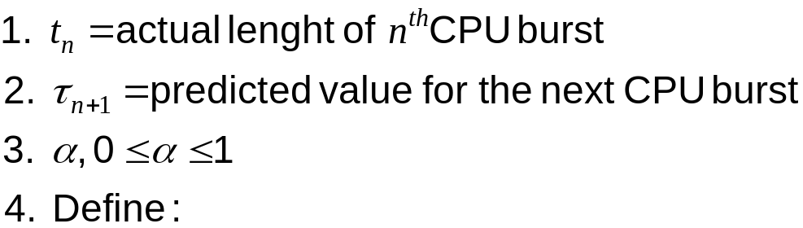

Determining Length of Next CPU Burst
Can only estimate the length.
Can be done by using the length of previous CPU bursts, using exponential averaging.
s

Slide 23

Prediction of the Length of the Next CPU Burst
s

Slide 24
Examples of Exponential Averaging
α =0
  τ_{n+1} = τ_{n}
  Recent history does not count.
α =1
  τ_{n+1} = t_{n}
  Only the actual last CPU burst counts.
If we expand the formula, we get:
    τ_{n+1} = α t_{n}+(1 - α) α t_{n} -1 + …
    +(1 - α )^{j} α t_{n} -1 + …
    +(1 - α )^{n=1} t_{n} τ₀
Since both α and (1 - α) are less than or equal to 1, each successive term has less weight than its predecessor.
s

Slide 25
Priority Scheduling
A priority number (integer) is associated with each process
The CPU is allocated to the process with the highest priority (smallest integer ≡ highest priority).
  Preemptive
  nonpreemptive
SJF is a priority scheduling where priority is the predicted next CPU burst time.
Problem ≡ Starvation – low priority processes may never execute.
Solution ≡ Aging – as time progresses increase the priority of the process.
s

Slide 26
Round-Robin
Selection function: same as FCFS
Decision mode: preemptive
  a process is allowed to run until the time slice period (quantum, typically from 10 to 100 ms) has expired
  then a clock interrupt occurs and the running process is put on the ready queue
s

Slide 27
Round Robin (RR)
Each process gets a small unit of CPU time (time quantum), usually 10-100 milliseconds. After this time has elapsed, the process is preempted and added to the end of the ready queue.
If there are n processes in the ready queue and the time quantum is q, then each process gets 1/n of the CPU time in chunks of at most q time units at once. No process waits more than (n-1)q time units.
Performance
  q large ⇒ FIFO
  q small ⇒ q must be large with respect to context switch, otherwise overhead is too high.
s

Slide 28
Example of RR with Time Quantum = 20
Process Burst Time
P₁ 53
P₂ 17
P₃ 68
P₄ 24
The Gantt chart is:
Typically, higher average turnaround than SJF, but better response.
P₁
P₂
P₃
P₄
P₁
P₃
P₄
P₁
P₃
P₃
0
20
37
57
77
97
117
121
134
154
162
s

Slide 29
Round Robin: critique
Still favors CPU-bound processes
  A I/O bound process uses the CPU for a time less than the time quantum and then is blocked waiting for I/O
  A CPU-bound process run for all its time slice and is put back into the ready queue (thus getting in front of blocked processes)
A solution: virtual round robin
  When a I/O has completed, the blocked process is moved to an auxiliary queue which gets preference over the main ready queue
  A process dispatched from the auxiliary queue runs no longer than the basic time quantum minus the time spent running since it was selected from the ready queue
s

Slide 30
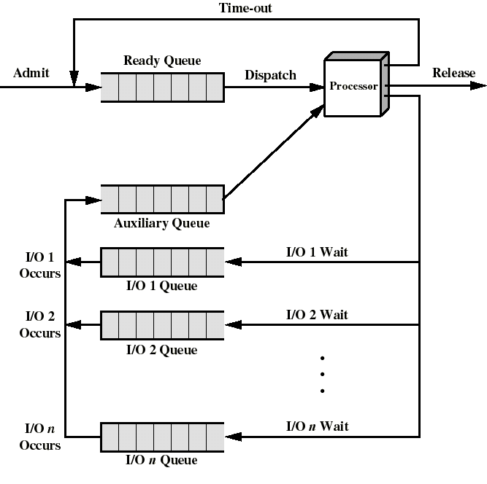
Queuing for Virtual Round Robin
s

Slide 31

Time Quantum and Context Switch Time
s

Slide 32

Turnaround Time Varies With The Time Quantum
s

Slide 33
Multilevel Queue
Ready queue is partitioned into separate queues:
foreground (interactive)
background (batch)
Each queue has its own scheduling algorithm,
foreground – RR
background – FCFS
Scheduling must be done between the queues.
  Fixed priority scheduling; (i.e., serve all from foreground then from background). Possibility of starvation.
  Time slice – each queue gets a certain amount of CPU time which it can schedule amongst its processes; i.e., 80% to foreground in RR
  20% to background in FCFS
s

Slide 34

Multilevel Queue Scheduling
s

Slide 35
Multilevel Feedback Queue
A process can move between the various queues; aging can be implemented this way.
Multilevel-feedback-queue scheduler defined by the following parameters:
  number of queues
  scheduling algorithms for each queue
  method used to determine when to upgrade a process
  method used to determine when to demote a process
  method used to determine which queue a process will enter when that process needs service
s

Slide 36
Example of Multilevel Feedback Queue
Three queues:
  Q₀ – time quantum 8 milliseconds
  Q₁ – time quantum 16 milliseconds
  Q₂ – FCFS
Scheduling
  A new job enters queue Q₀ which is served FCFS. When it gains CPU, job receives 8 milliseconds. If it does not finish in 8 milliseconds, job is moved to queue Q₁.
  At Q₁ job is again served FCFS and receives 16 additional milliseconds. If it still does not complete, it is preempted and moved to queue Q₂.
s

Slide 37

Multilevel Feedback Queues
s

Slide 38
Multiple-Processor Scheduling
CPU scheduling more complex when multiple CPUs are available.
Homogeneous processors within a multiprocessor.
Load sharing
Asymmetric multiprocessing – only one processor accesses the system data structures, alleviating the need for data sharing.
s

Slide 39
Real-Time Scheduling
Hard real-time systems – required to complete a critical task within a guaranteed amount of time.
Soft real-time computing – requires that critical processes receive priority over less fortunate ones.
s

Slide 40

Dispatch Latency
s

Slide 41
Algorithm Comparison
Which one is best?
The answer depends on:
  on the system workload (extremely variable)
  hardware support for the dispatcher
  relative weighting of performance criteria (response time, CPU utilization, throughput...)
  The evaluation method used (each has its limitations...)
Hence the answer depends on too many factors to give any...
s

Slide 42
Algorithm Evaluation
Deterministic modeling – takes a particular predetermined workload and defines the performance of each algorithm for that workload.
Queueing models
Implementation
s

Slide 43

Evaluation of CPU Schedulers by Simulation
s

